Slide 1
Chapter 11:
File-System Interface

Slide 2
Chapter 11: File-System Interface
File Concept
Access Methods
Disk and Directory Structure
File-System Mounting
File Sharing
Protection

Slide 3
Objectives
To explain the function of file systems
To describe the interfaces to file systems
To discuss file-system design tradeoffs, including access methods, file sharing, file locking, and directory structures
To explore file-system protection

Slide 4
Computers can store information on various storage media, such as magnetic disks, magnetic tapes, and optical disks.
So that the computer system will be convenient to use, the operating system provides a uniform logical view of stored information.
The operating system abstracts from the physical properties of its storage devices to define a logical storage unit,the file.
Files are mapped by the operating system onto physical devices. These storage devices are usually nonvolatile, so the contents are persistent between system reboots.
A file is a named collection of related information that is recorded on secondary storage.
From a user’s perspective, a file is the smallest allotment of logical secondary storage; that is, data cannot be written to secondary storage unless they are within a file.

Slide 5
Data files may be numeric, alphabetic, alphanumeric, or binary. Files may be free form, such as text files, or may be formatted rigidly.
In general, a file is a sequence of bits, bytes, lines, or records, the meaning of which is defined by the file’s creator and user.
The information in a file is defined by its creator. Many different types of information may be stored in a file—source or executable programs,numeric or text data, photos, music, video,and soon.
A file has a certain defined structure, which depends on its type.
A text file is a sequence of characters organized into lines (and possibly pages).
A source file is a sequence of functions, each of which is further organized as declarations followed by executable statements.
An executable file is a series of code sections that the loader can bring into memory and execute.

Slide 6
File Concept
A file is named for the convenience of users and referred by their names.
When a file is named, it becomes independent of the process, the user, and even the system that created it.
For instance, one user might create the file example.c, and another user might edit that file by specifying its name. The file’s owner might write the file to a USB disk, send it as ane-mail attachment, or copy it across a network, and it could still be called example.c on the destination system.
Contiguous logical address space
Types:
  Data
    numeric
    character
    binary
  Program
Contents defined by file’s creator
  Many types
    Consider text file, source file, executable file

Slide 7
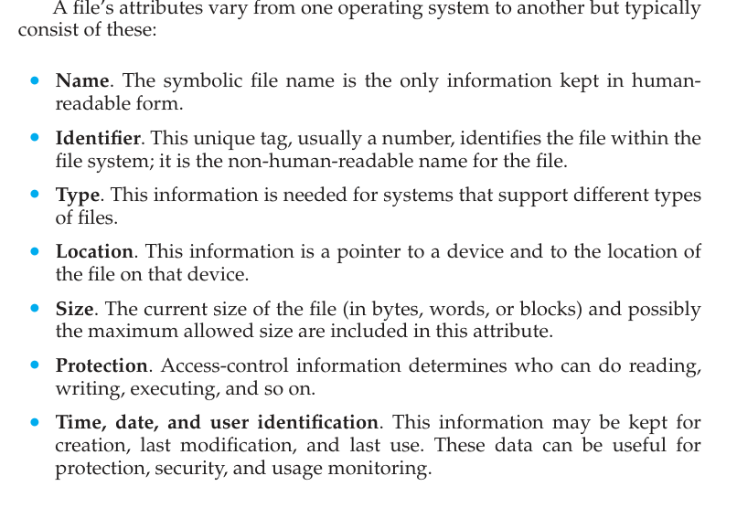

Slide 8
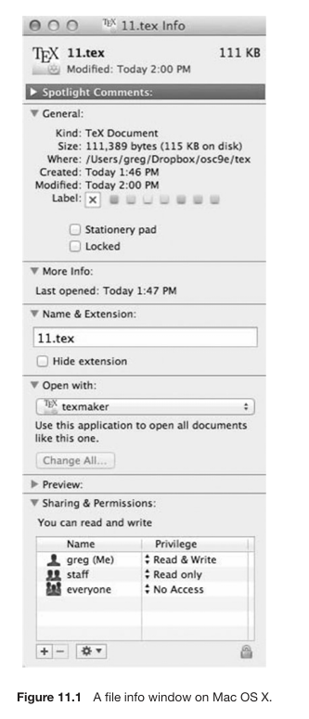

Slide 9
File Attributes
Some newer file systems also support extended file attributes, including character encoding of the file and security features such as a file checksum.
Information about files are kept in the directory structure, which is maintained on the disk,
Typically, a directory entry consists of the f ile’s name and its unique identifier. The identifier in turn locates the other f ile attributes. It may take more than a kilobyte to record this information for each file.

Slide 10
File Operations
A file is an abstract data type. To define a file properly, we need to consider the operations that can be performed on files.
The operating system can provide system calls to create, write, read, reposition, delete, and truncate files.

Slide 11
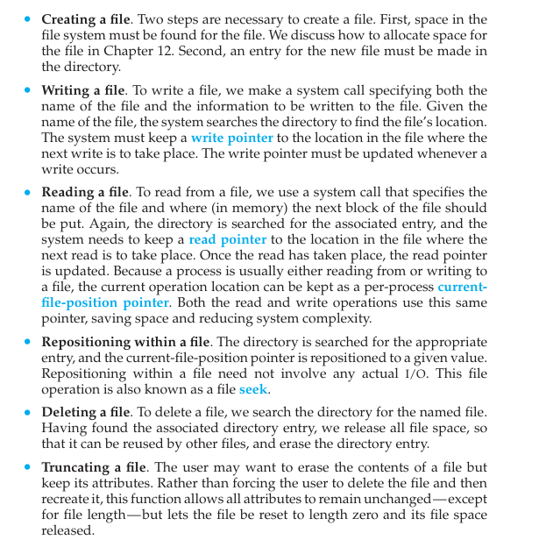

Slide 12
Other common operations include appending new information to the end of an existing file and renaming an existing file.
These primitive operations can then be combined to perform other file operations.For instance, we can create a copy of a file—or copy the file to another I/O device, such as a printer or a display—by creating a new file and then reading from the old and writing to the new. We also want to have operations that allow a user to get and set the various attributes of a file.
For example, we may want to have operations that allow a user to determine the status of a file, such as the file’s length, and to set file attributes, such as the file’s owner.

Slide 13
Open Files
Most of the file operations mentioned involve searching the directory for the entry associated with the named file.
To avoid this constant searching, many systems require that an open() system call be made before a file is first used.
When a file operation is requested, the file is specified via an index into this table, so no searching is required. When the file is no longer being actively used, it is closed by the process, and the operating system removes its entry from the open-file table.
create() and delete()are system calls that work with closed rather than open files. Several pieces of data are needed to manage open files:
  Open-file table: tracks open files
  File pointer: pointer to last read/write location, per process that has the file open
  File-open count: counter of number of times a file is open – to allow removal of data from open-file table when last processes closes it
  Disk location of the file: cache of data access information
  Access rights: per-process access mode information

Slide 14
The implementation of the open() and close() operations is more complicated in an environment where several processes may open the file simultaneously.
This may occur in a system where several different applications open the same file at the same time. Typically, the operating system uses two levels of internal tables: a per-process table and a system-wide table.
The per process table tracks all files that a process has open. Stored in this table is information regarding the process’s use of the file. For instance, the current file pointer for each file is found here. Access rights to the file and accounting information can also be included.
Each entry in the per-process table in turn points to a system-wideopen-file table. The system-wide table contains process-independent information, such as the location of the file on disk, access dates, and file size.
Once a file has been opened by one process, the system-wide table includes an entry for the file..

Slide 15
When another process executes an open() call, a new entry is simply added to the process’s open-file table pointing to the appropriate entry in the system-wide table.
Typically, the open-file table also has an open count associated with each file to indicate how many processes have the file open.
Each close() decreases this open count, and when the open count reaches zero, the file is no longer in use, and the file’s entry is removed from the open-file table.

Slide 16
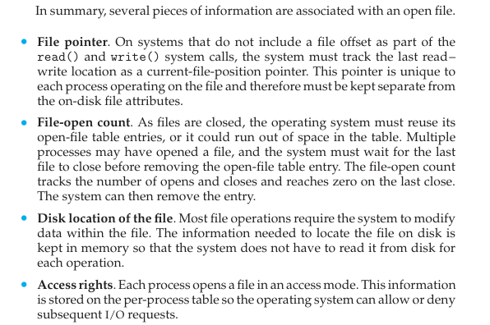

Slide 17
Open File Locking
Provided by some operating systems and file systems
  Similar to reader-writer locks
  Shared lock similar to reader lock – several processes can acquire concurrently
  Exclusive lock similar to writer lock
Mediates access to a file
Mandatory or advisory:
  Mandatory – access is denied depending on locks held and requested
  Advisory – processes can find status of locks and decide what to do

Slide 18
File Locking Example – Java API
import java.io.*;
import java.nio.channels.*;
public class LockingExample {
public static final boolean EXCLUSIVE = false;
public static final boolean SHARED = true;
public static void main(String arsg[]) throws IOException {
FileLock sharedLock = null;
FileLock exclusiveLock = null;
try {
RandomAccessFile raf = new RandomAccessFile("file.txt", "rw");
// get the channel for the file
FileChannel ch = raf.getChannel();
// this locks the first half of the file - exclusive
exclusiveLock = ch.lock(0, raf.length()/2, EXCLUSIVE);
/** Now modify the data . . . */
// release the lock
exclusiveLock.release();

Slide 19
File Locking Example – Java API (Cont.)
// this locks the second half of the file - shared
sharedLock = ch.lock(raf.length()/2+1, raf.length(), SHARED);
/** Now read the data . . . */
// release the lock
sharedLock.release();
} catch (java.io.IOException ioe) {
System.err.println(ioe);
}finally {
if (exclusiveLock != null)
exclusiveLock.release();
if (sharedLock != null)
sharedLock.release();
}
}
}

Slide 20

File Types – Name, Extension

Slide 21
File Structure
None - sequence of words, bytes
Simple record structure
  Lines
  Fixed length
  Variable length
Complex Structures
  Formatted document
  Relocatable load file
Can simulate last two with first method by inserting appropriate control characters
Who decides:
  Operating system
  Program

Slide 22

Sequential-access File

Slide 23
Access Methods
Sequential Access
read next
write next
reset
no read after last write
(rewrite)
Direct Access – file is fixed length logical records
read n
write n
position to n
read next
write next
rewrite n
n = relative block number
Relative block numbers allow OS to decide where file should be placed
  See allocation problem in Ch 12

Slide 24

Simulation of Sequential Access on Direct-access File

Slide 25
Other Access Methods
Can be built on top of base methods
General involve creation of an index for the file
Keep index in memory for fast determination of location of data to be operated on (consider UPC code plus record of data about that item)
If too large, index (in memory) of the index (on disk)
IBM indexed sequential-access method (ISAM)
  Small master index, points to disk blocks of secondary index
  File kept sorted on a defined key
  All done by the OS
VMS operating system provides index and relative files as another example (see next slide)

Slide 26

Example of Index and Relative Files

Slide 27
Directory Structure
A collection of nodes containing information about all files
Directory
Files
F 1
F 2
F 3
F 4
F n
Both the directory structure and the files reside on disk

Slide 28
Disk Structure
Disk can be subdivided into partitions
Disks or partitions can be RAID protected against failure
Disk or partition can be used raw – without a file system, or formatted with a file system
Partitions also known as minidisks, slices
Entity containing file system known as a volume
Each volume containing file system also tracks that file system’s info in device directory or volume table of contents
As well as general-purpose file systems there are many special-purpose file systems, frequently all within the same operating system or computer

Slide 29

A Typical File-system Organization

Slide 30
Types of File Systems
We mostly talk of general-purpose file systems
But systems frequently have may file systems, some general- and some special- purpose
Consider Solaris has
  tmpfs – memory-based volatile FS for fast, temporary I/O
  objfs – interface into kernel memory to get kernel symbols for debugging
  ctfs – contract file system for managing daemons
  lofs – loopback file system allows one FS to be accessed in place of another
  procfs – kernel interface to process structures
  ufs, zfs – general purpose file systems

Slide 31
Operations Performed on Directory
Search for a file
Create a file
Delete a file
List a directory
Rename a file
Traverse the file system

Slide 32
Directory Organization
The directory is organized logically to obtain
Efficiency – locating a file quickly
Naming – convenient to users
  Two users can have same name for different files
  The same file can have several different names
Grouping – logical grouping of files by properties, (e.g., all Java programs, all games, …)

Slide 33

Single-Level Directory
A single directory for all users
Naming problem
Grouping problem

Slide 34

Two-Level Directory
Separate directory for each user
Path name
Can have the same file name for different user
Efficient searching
No grouping capability

Slide 35

Tree-Structured Directories

Slide 36
Tree-Structured Directories (Cont.)
Efficient searching
Grouping Capability
Current directory (working directory)
  cd /spell/mail/prog
  type list

Slide 37

Tree-Structured Directories (Cont)
Absolute or relative path name
Creating a new file is done in current directory
Delete a file
rm <file-name>
Creating a new subdirectory is done in current directory
  mkdir <dir-name>
  Example: if in current directory /mail
  mkdir count
Deleting “mail” ⇒ deleting the entire subtree rooted by “mail”

Slide 38

Acyclic-Graph Directories
Have shared subdirectories and files

Slide 39
Acyclic-Graph Directories (Cont.)
Two different names (aliasing)
If dict deletes list ⇒ dangling pointer
Solutions:
  Backpointers, so we can delete all pointers
  Variable size records a problem
  Backpointers using a daisy chain organization
  Entry-hold-count solution
New directory entry type
  Link – another name (pointer) to an existing file
  Resolve the link – follow pointer to locate the file

Slide 40

General Graph Directory

Slide 41
General Graph Directory (Cont.)
How do we guarantee no cycles?
  Allow only links to file not subdirectories
  Garbage collection
  Every time a new link is added use a cycle detection algorithm to determine whether it is OK

Slide 42

File System Mounting
A file system must be mounted before it can be accessed
A unmounted file system (i.e., Fig. 11-11(b)) is mounted at a mount point

Slide 43

Mount Point

Slide 44
File Sharing
Sharing of files on multi-user systems is desirable
Sharing may be done through a protection scheme
On distributed systems, files may be shared across a network
Network File System (NFS) is a common distributed file-sharing method
If multi-user system
  User IDs identify users, allowing permissions and protections to be per-user
  Group IDs allow users to be in groups, permitting group access rights
  Owner of a file / directory
  Group of a file / directory

Slide 45
File Sharing – Remote File Systems
Uses networking to allow file system access between systems
  Manually via programs like FTP
  Automatically, seamlessly using distributed file systems
  Semi automatically via the world wide web
Client-server model allows clients to mount remote file systems from servers
  Server can serve multiple clients
  Client and user-on-client identification is insecure or complicated
  NFS is standard UNIX client-server file sharing protocol
  CIFS is standard Windows protocol
  Standard operating system file calls are translated into remote calls
Distributed Information Systems (distributed naming services) such as LDAP, DNS, NIS, Active Directory implement unified access to information needed for remote computing

Slide 46
File Sharing – Failure Modes
All file systems have failure modes
  For example corruption of directory structures or other non-user data, called metadata
Remote file systems add new failure modes, due to network failure, server failure
Recovery from failure can involve state information about status of each remote request
Stateless protocols such as NFS v3 include all information in each request, allowing easy recovery but less security

Slide 47
File Sharing – Consistency Semantics
Specify how multiple users are to access a shared file simultaneously
  Similar to Ch 5 process synchronization algorithms
    Tend to be less complex due to disk I/O and network latency (for remote file systems
  Andrew File System (AFS) implemented complex remote file sharing semantics
  Unix file system (UFS) implements:
    Writes to an open file visible immediately to other users of the same open file
    Sharing file pointer to allow multiple users to read and write concurrently
  AFS has session semantics
    Writes only visible to sessions starting after the file is closed

Slide 48
Protection
File owner/creator should be able to control:
  what can be done
  by whom
Types of access
  Read
  Write
  Execute
  Append
  Delete
  List

Slide 49

Access Lists and Groups
Mode of access: read, write, execute
Three classes of users on Unix / Linux
RWX
a) owner access 7 ⇒ 1 1 1
RWX
b) group access 6 ⇒ 1 1 0
RWX
c) public access 1 ⇒ 0 0 1
Ask manager to create a group (unique name), say G, and add some users to the group.
For a particular file (say game) or subdirectory, define an appropriate access.
Attach a group to a file
chgrp G game

Slide 50

Windows 7 Access-Control List Management

Slide 51

A Sample UNIX Directory Listing

Slide 52
End of Chapter 11

